Slide 1

Final project For Introduction to Machine Learning: Supervised Learning
SA146003, Takuto Nishimura

Slide 2

Project topic
Step 1: Data Check
Step 2: EDA (Heat Map, Lag Data)
Step 3: Model building and Evaluation
Step 4: Results of model evaluation
Step 5: Conclusion

Slide 3
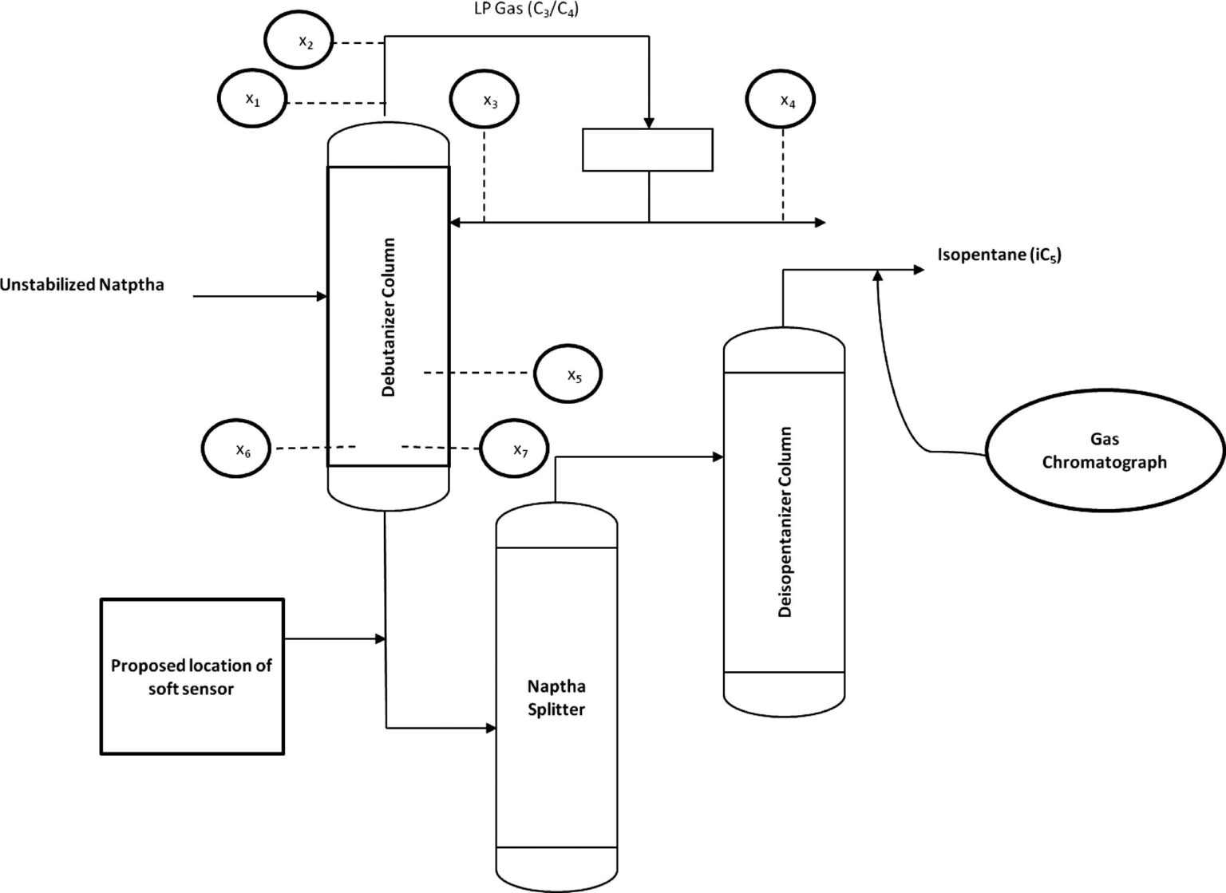
Project topic
Development of soft sensors for chemical processes
Naphtha from petroleum is a mixture of various components. It has to be separated into each useful component by chemical processes.
Data: Predictor X
Sampling
Operational
Control
Delay
x1-x7
Predict: Butane concentration
Purpose : Predict Butane concentration(y) from x1-x7 without sampling

Slide 4
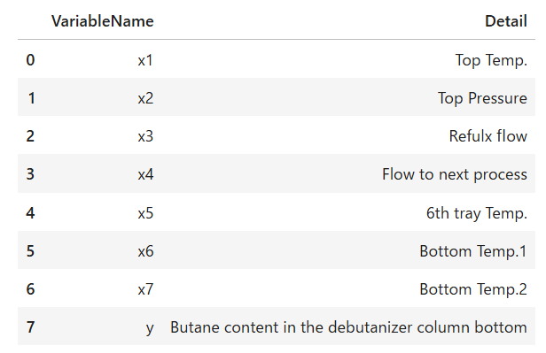
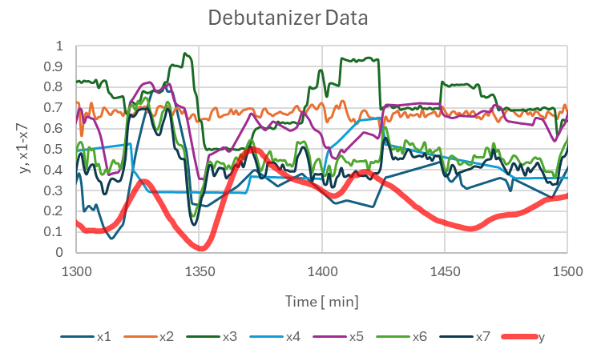
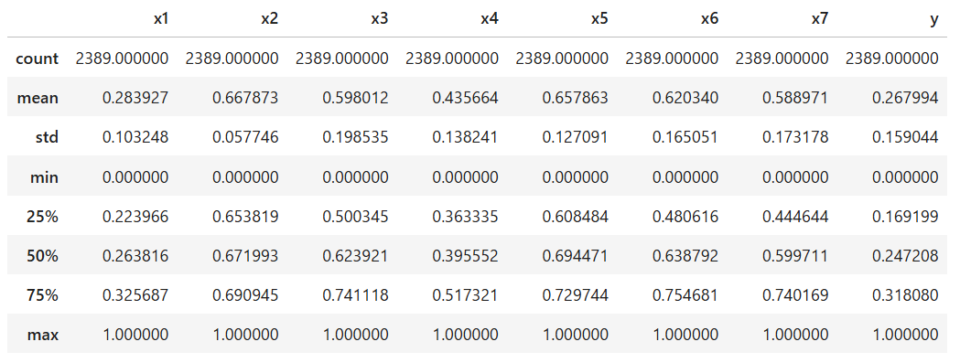
Step 1: Data Check
Detail
Time series data

Slide 5

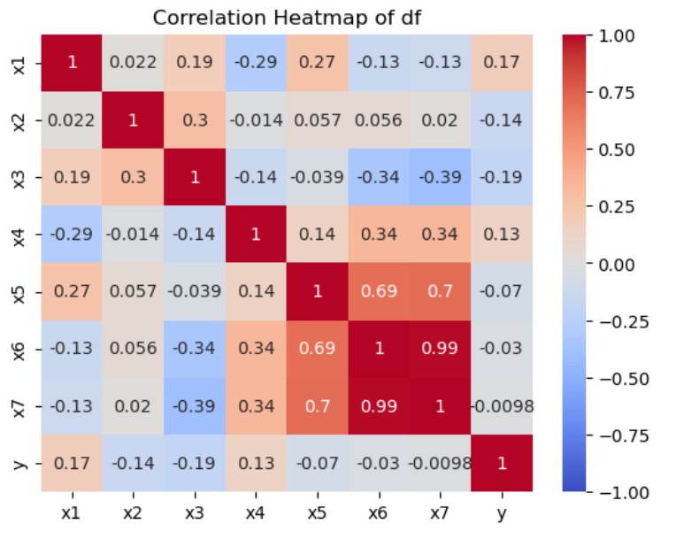
Step 2: EDA
Delete NaN
Check Heat map
No correlation?
Lag time = 5-30min?
Action
Effect

Slide 6
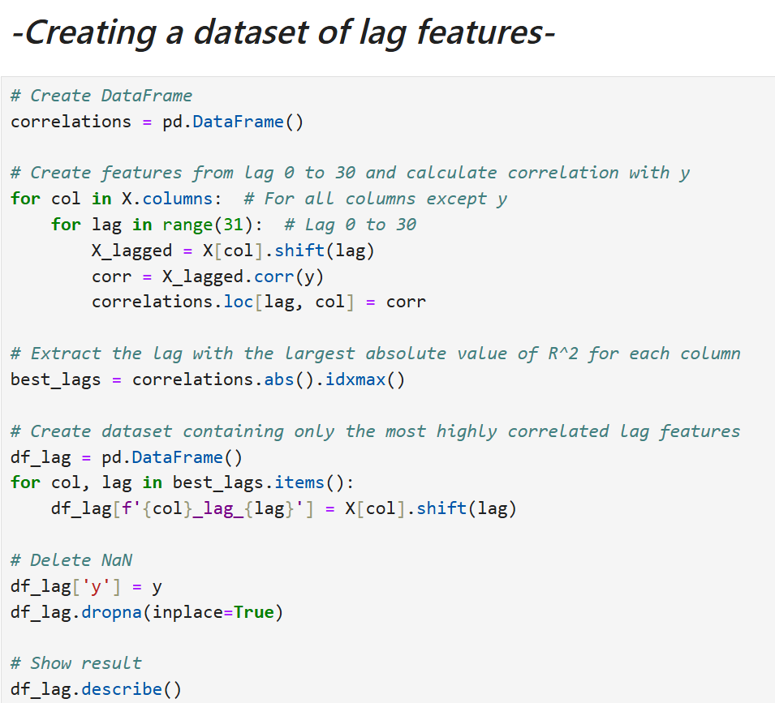
Step 2: Lag Data
What’s lag time?
Lag time = 5-30min?
Action
Effect

Slide 7
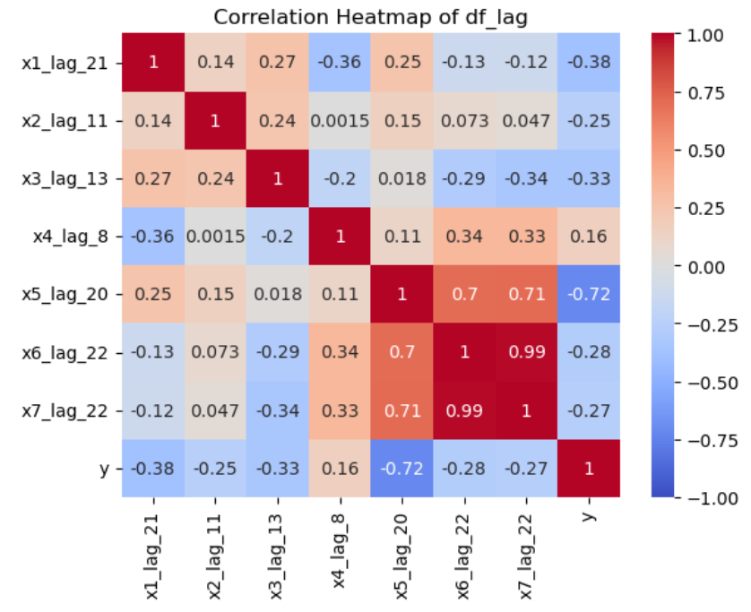
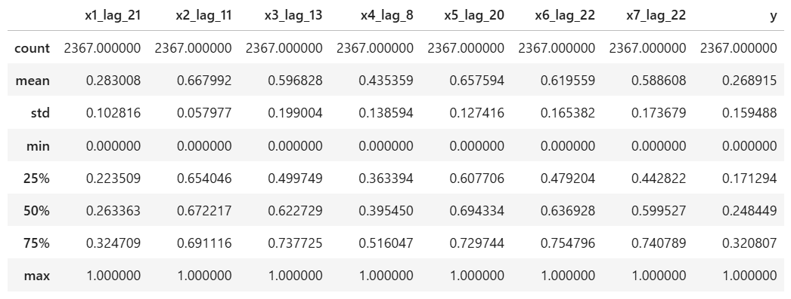
Step 2: Lag Data
Check Heat map again
UP↑

Slide 8
Step 3: Model building and Evaluation
R^2, RMSE, MAE
Actual y vs Predicted y
60%
Training
40%
Test
Predicted TimeSeries y
Model
Model
Random Forest (max_depth=3, number_of_trees=300, max_features; tune by out of bag test)
Adaboost (base_estimator=DT, learning_rate=0.01)
Multiple linear regression

Slide 9
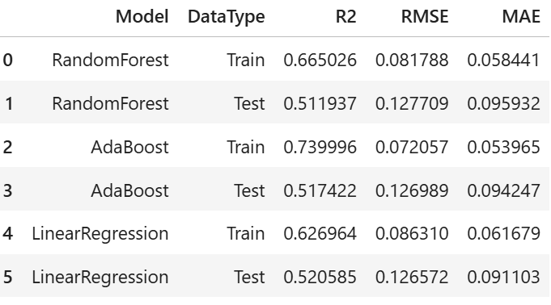
Step 4: Result of evaluation

Slide 10
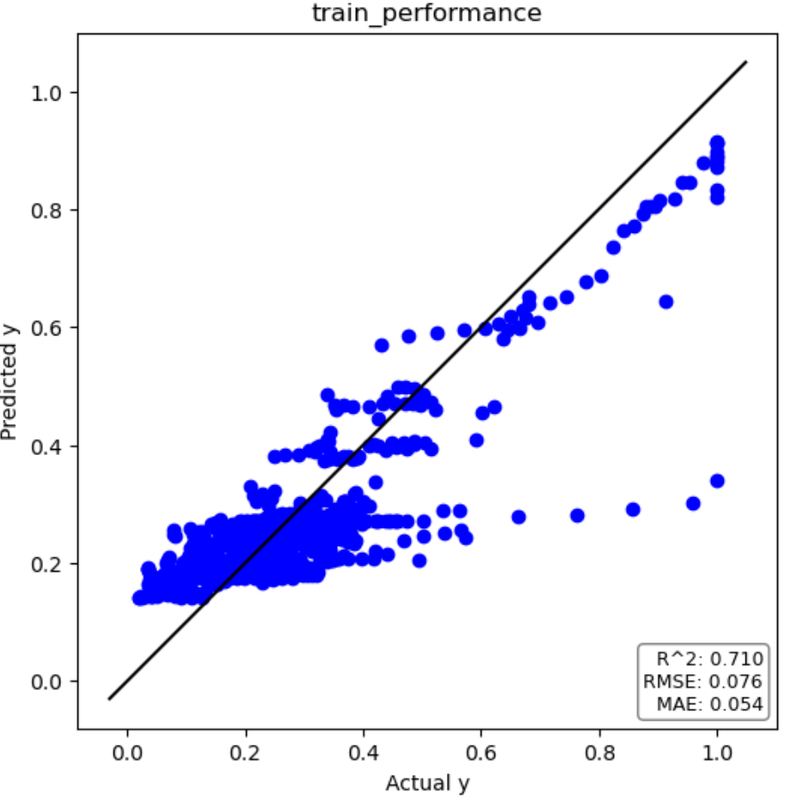
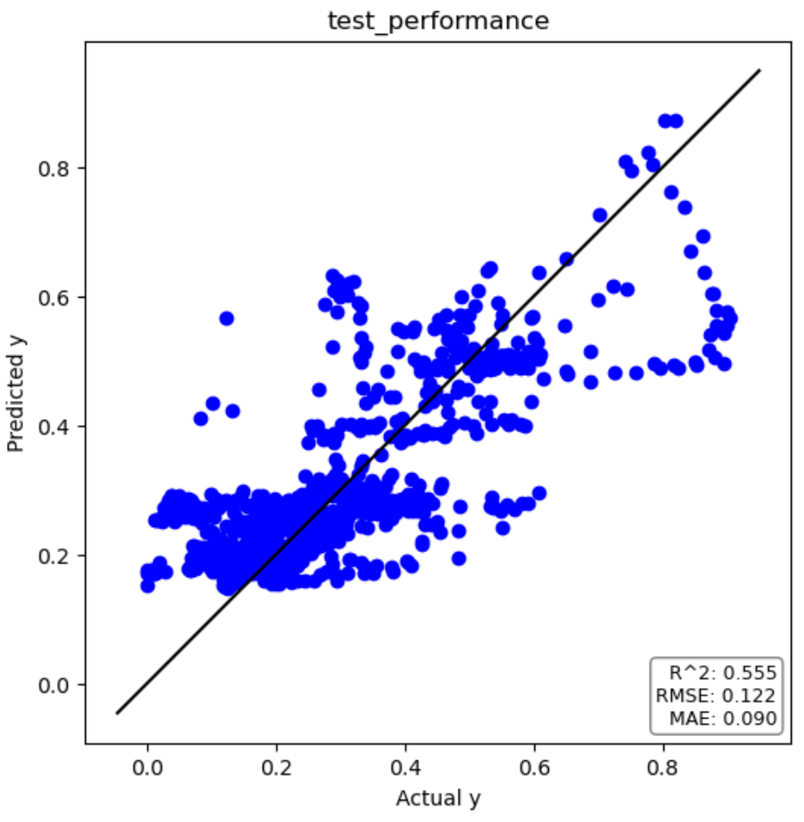

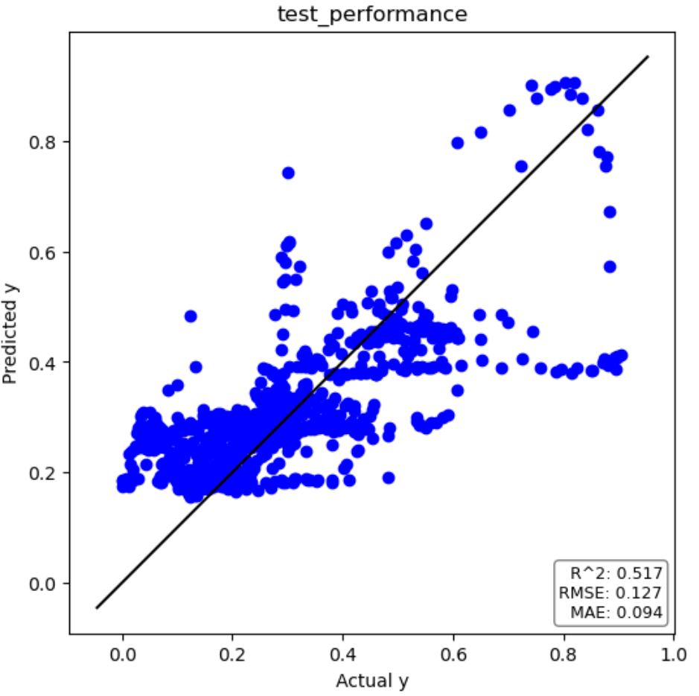
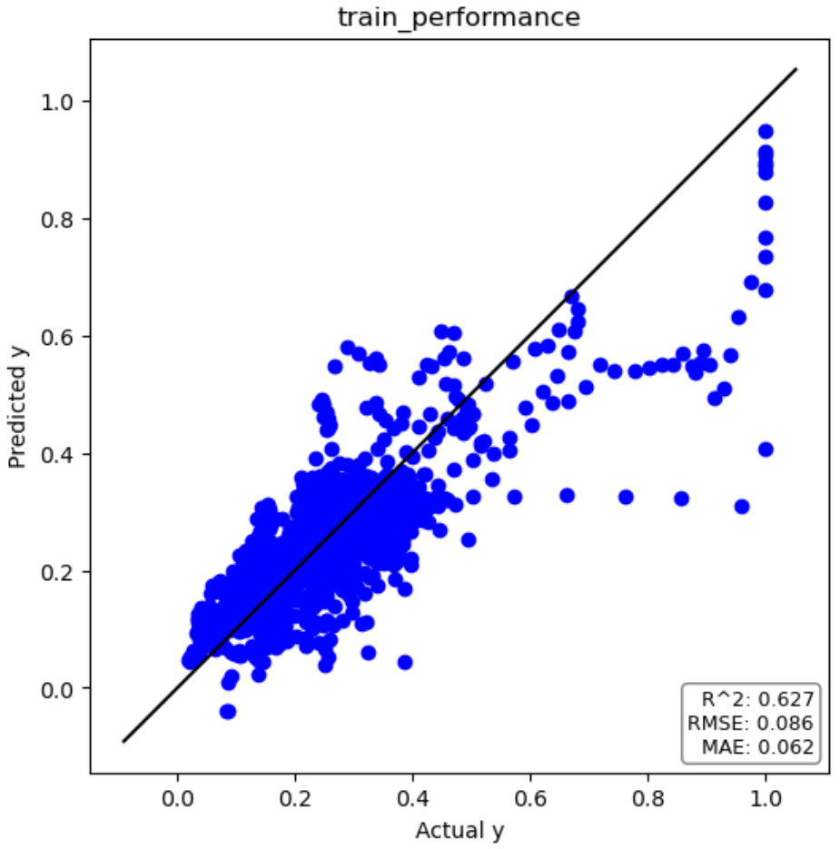
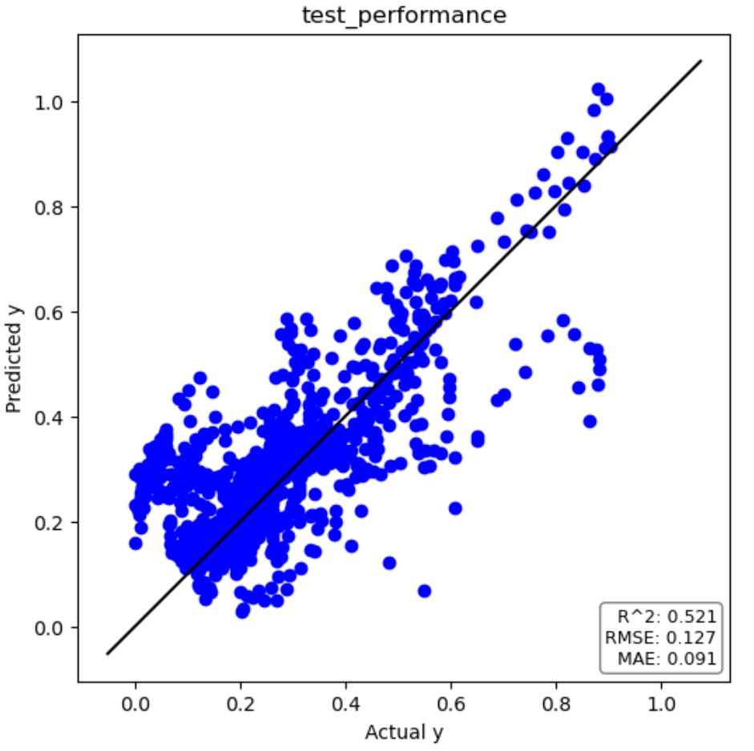
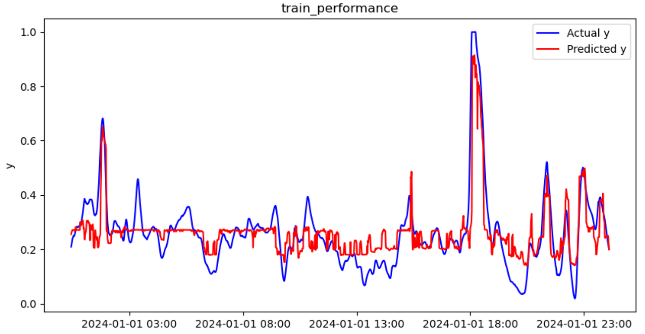
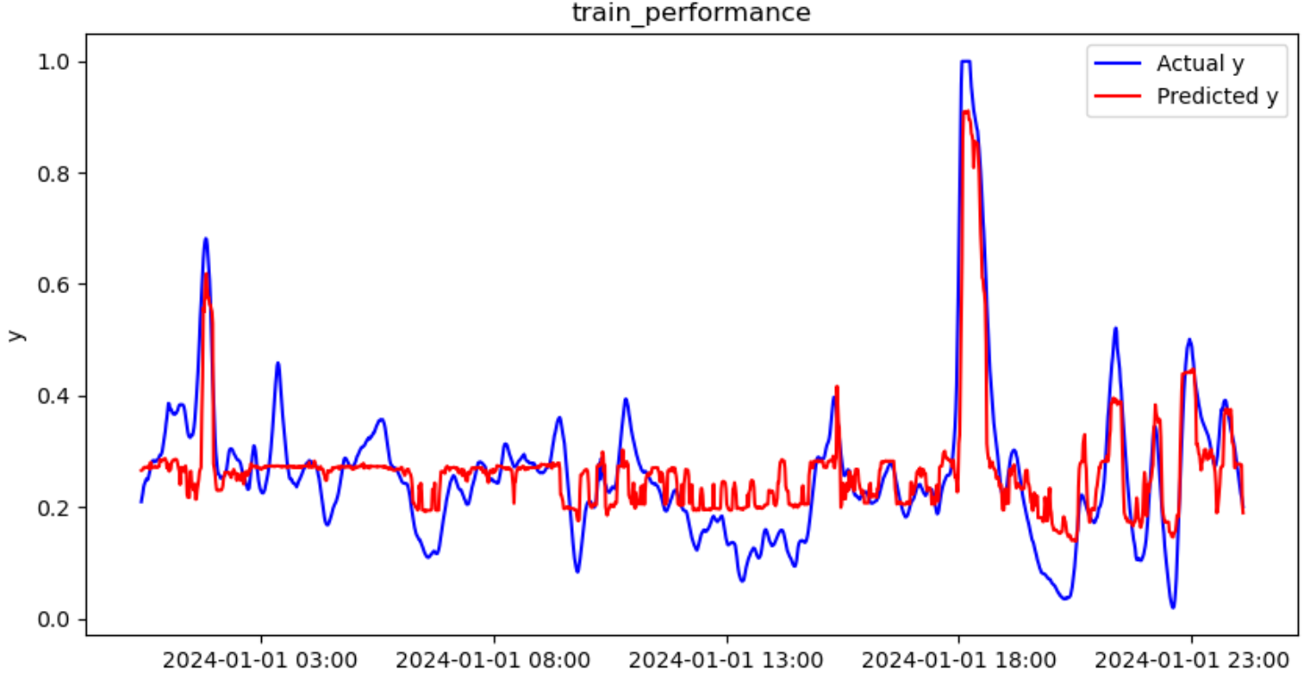
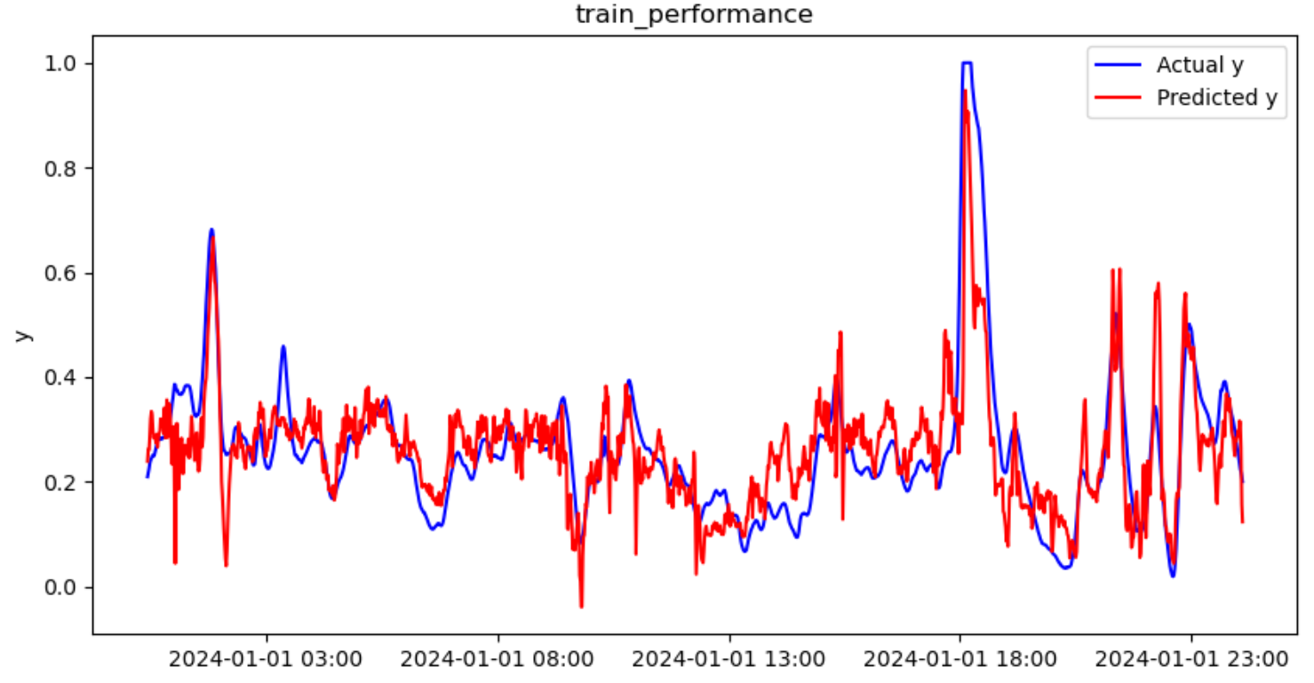
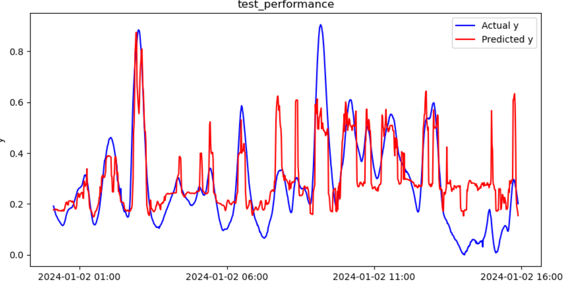
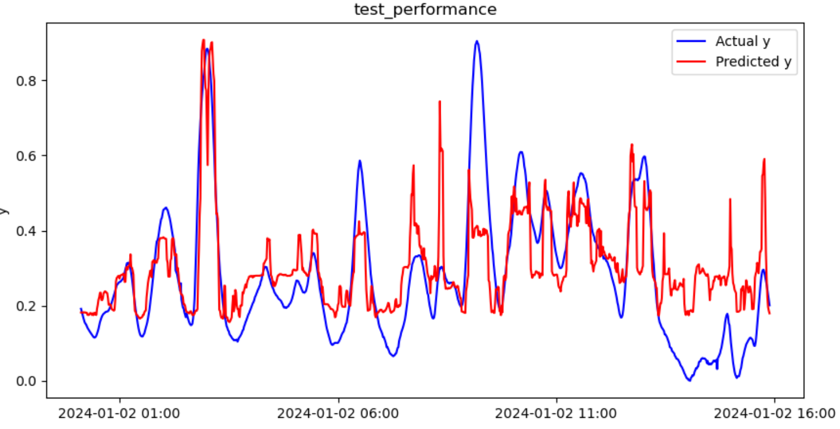
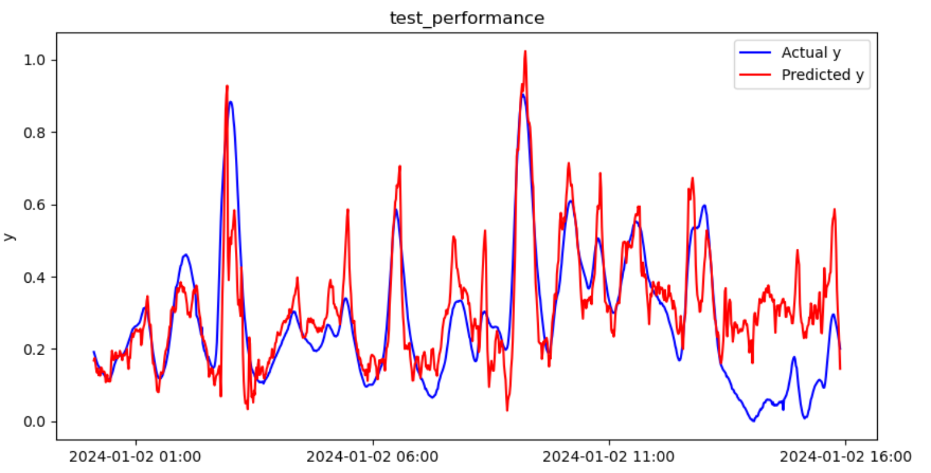
Step 4: Result of evaluation
RandomForest
Adaboost
MLR

Slide 11
Step 5: conclusion
Create Prototype of a soft sensor for chemical processes By MLR
→As a next step, Need validation with other data than test data

Slide 12

THANK YOU

